Slide 1
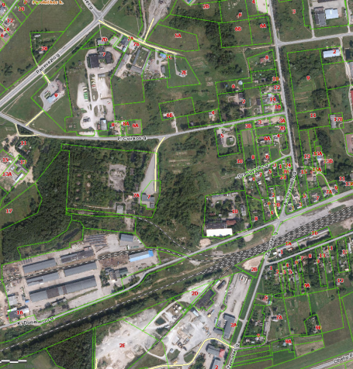

Commercial Land
Rokiskis District Municipality Administration
Plan of the land Photo of the land
Address | Rokiškio m., P.Cvirkos – Donelaičio g. 5
Lot size | 1,7043Ha
Electricity | 200m distance to substation of power system
Water | 80 m, d100 mm distance to water network
Telecommunications | 80 m distance to internet, telephone network
Distance to the main road | 0,04Km
Price/other conditions | Has not offerred for sale at an auction Detailed plan has prepared Land is industrial ( for storehouse)

